Slide 1

8th Global Islamic
Microfinance Forum, Dubai
25th-26th Nov. 2018
Microfinance-Challenges in Skills Enhancement for Poverty Eradication
By: Aijaz Ali Khuwaja

Slide 2
Poverty Eradication Initiative (PEI)- Introduction
PEI established in 2002, is a non-profit organization, striving to alleviate poverty and bring about a positive change in lives of the poorest of the poor.
Since the time of establishment, PEI has been striving in partnership with community to develop a society based on three core values of sustainable human development: self-esteem, freedom of choice and tolerance, a society where everyone has equal access to opportunities and justice irrespective of gender and status.

Slide 3
Sindh Peoples Health Program
The Sindh Peoples Heath Program (SPHP) is a three-year initiative designed to implement a Universal Health Coverage (UHC) approach to strengthen health systems in Sindh. The program is implemented in partnership with the Public-Private Partnership (PPP) Node of the Department of Health, Government of Sindh. 30% of the program is being funded by the PPP Node, GoS and 70% is funded by PEI.
SPHP has established 50 plus free medical and surgical supplies counters in different DHQs/THQs all around Sindh. Currently, SPHP is working on establishment of 450 Midwifery led Birth Centers (MLBCs) in far flung poorest of the poor areas of Sindh. SPHP is also providing health education in 2400 schools of remote areas of Sindh.
The program is working across all 29 districts of Sindh. This intervention is designed to improve access to quality medical services, especially for the poorest members of the community in order to reduce out of pocket payments (OOPP), hence, providing them financial risk protection.

Slide 4
Microfinance Initiatives in Pakistan
The Aga Khan Rural Support Program (AKRSP) started in 1980’s & then after the success of AKRSP, National Rural Support Program was established in 1990’s.
Now in Pakistan we have ten Provincial and National level Rural Support Programs.
All four provinces have RSP supported by the government and donors

Slide 5
Village Organization Banking & Community Investment Fund
Village Organisation Banking system was first introduced by AKRSP in Pakistan
VO Banking System was based on Land Development, Agriculture Development, Credit & Banking & Marketing
After success of VO Banking system, Rural Micro-financing was started all over rural areas in Pakistan through different initiatives
Banking sector is now actively providing microfinance to semi urban and urban areas

Slide 6
Rural Micro-financing in Sindh
Rural micro-financing is still at nascent age in rural setup of Sindh, Pakistan.
The involvement of Banking sector in rural micro-financing is yet to establish.
The First Micro-Finance Bank, Tameer Bank, Khushali Bank & other regular banking sector is now gradually establishing their local branches in Sindh, Pakistan.
Rural Microfinancing is only catering needs of 10% to 12% of rural communities in Sindh Pakistan.

Slide 7
Rural Micro-financing
Pakistan’s current population is around 204.7 million as per census 2018.
The poverty ratio is around 45% (according to BBSYDP poverty score card).
Devastating floods and related seasonal issues have affected income of rural masses which ultimately increased poverty ratio specially in rural areas.
Microfinance is not a sustainable solution of poverty
Microfinance coverage is very slow due to different reasons.

Slide 8
Rural Micro-financing-Case Study Sindh
The most important feature of Community Based Micro-finance initiative is that community is itself monitoring their own development and reporting to organisation on regular basis.
Mostly female CSOs have identified female members for lending of micro-finance. They are giving their own guarantee for return of money on regular basis.
The access of poorest of the poor female community to microfinancing is only 3% . Still around 97% rural female community in Sindh have no access to microfinance.

Slide 9
Micro-finance Nexus with Technical Skills
Microfinance in Pakistan is still at nascent age and only 12% to 15% community in rural and semi urban setup is getting benefit.
Financial Institutions are working in isolation in rural areas of Pakistan.
Public/Private Financial Institutions are giving less or no priority to rural downtrodden communities due to their chronic poverty and vulnerability. Rural masses have no proper access to regular banking system.
RSPs are giving priority but they have not sufficient funding to reach all poor areas in all 106 districts of Pakistan.
TVET sector in Pakistan is also catering around 3% population in Pakistan. TVET sector has very low access to rural areas where above 65% population is living.
Microfinance have greater link with technical skills

Slide 10
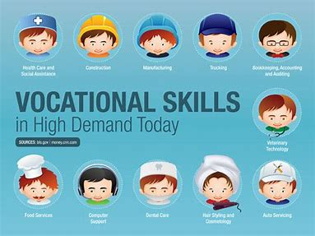
TVET Sector in Demand

Slide 11
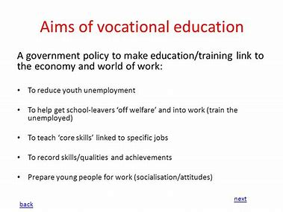
TVET Aims & Objectives

Slide 12
Micro-finance-Technical Skills Challenges
Microfinance institutions have emerged as a popular and credible instrument of poverty alleviation and .
Technical skills ,organizational and communication abilities provide better results for MFIs performance. .
It is important that banks understand that consumer protection and financial literacy are part of the investment, not an expense. Skills are must for the success of microfinance.
Aspirations of the Poor are growing, and as a result, they require loan and savings products to invest in education, healthcare and other safety nets.
Investment in technical skills will sustain microfinance investments

Slide 13
Micro-finance-Technical Skills Challenges
The microfinance sector serves as a model and, in many ways, has created the foundation for future financial inclusion regulations. These regulations needs to be redesign as per the needs of current interventions & changes in free world markets.
There must be a paradigm shift – even though demand exists, financial institutions have fallen behind in innovating products to meet demand.
Sharing knowledge and experience is important. There must be communication among all the institutions involved, and out ‐ sourcing should be encouraged when a particular institution cannot provide a needed product.

Slide 14
Micro-Finance-TVET Skills Challenges
Strengthening the role of government, in terms of policy guidance and incentives, would accelerate the building of social credit schemes and innovation in financial inclusion.
Making micro-finance more Islamic & demand driven as per market rules & regulations.
Lower administrative/financial cost & work on roll over basis micro-finance initiatives.
Ensure Microfinance investment in TVET sector for sustainability of initiatives
Introduction of Islamic Micro-finance public and private Banking sector in rural areas of Pakistan

Slide 15
Recommendations
Islamic Micro-financing is a new paradigm for rural masses in Pakistan.
Private & Public extensive Banking advocacy is required to achieve Islamic ways of micro-financing.
Not for Profit Organisations are now using term of “Financial Rolling” in micro-finance sector, which is a positive indicator towards “No profit No loss’’ philosophy.
Around 12 million young Pakistanis are out of school and this lot is now Young population
This 12 million out of school young Pakistanis need technical education. Microfinance can be diverted towards skills enhancement of this young population.

Slide 16
Recommendations
A joint venture of Public/Private & Not for Profit Organisations in Islamic Micro-financing is required.
Strong Community Mobilisation is required for each and every micro-finance initiatives in rural setup.
Introduction of new microfinance initiative in TVET sector is a MUST
Microfinance in Health, Education, Agriculture & Livestock sector will reduce poverty of downtrodden masses
Social Mobilisation of Client is key of Microfinance Institutions & Banking Sector is relying on financial rules & regulations, so joint venture of social mobilisation and relaxed financial rules will support to rural masses.

Slide 17
Recommendations
Agricultural microfinance must take into consideration the special circumstances affecting agribusiness, such as seasonal fluctuations in production, changes in food prices and problems specific to a given rural area.
There is need of skills enhancement in sectors like Agriculture, food chain system & small business.
How to close the gap between specialized demand and products supplied? More Knowledge sharing, as well as additional innovation, are needed blending approaches across business model archetypes.
Effective financial service for small agribusiness requires specialized workable products, as well as client and risk assessment techniques that take into account the variegations of farming.

Slide 18
Recommendations
Banks with Islamic micro-finance portfolio should take full advantage of their vast urban and rural network in order to reach the largest number of clients.
Microfinance for sustainability & poverty eradication through skills enhancement….This can be a new paradigm shift??
It may be useful to create a platform for the exchange of financial inclusion experiences, so as to diminish inconsistencies among financial inclusion best practices in different countries.
Strengthening the role of government, in terms of policy guidance and incentives, would accelerate the building of social credit schemes and innovation in financial inclusion.

Slide 19
Recommendations
Governments and donors that aim to extend the outreach of financial services, particularly to remote and poor areas targeting the poorest women, should invest in the role out of CIF across the organized communities in Pakistan.
Ensure sustainability of all micro-financial initiatives to get poor out of poverty and to achieve UN declared SDGs.
Enhancement of skills can sustain poverty eradication initiatives

Slide 20
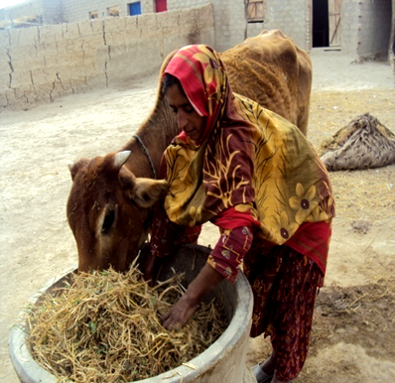
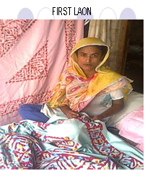
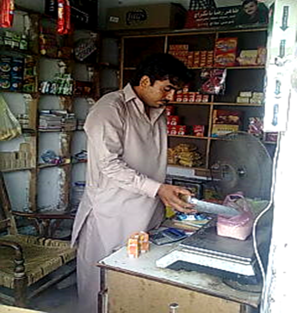
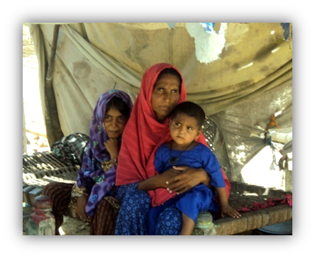
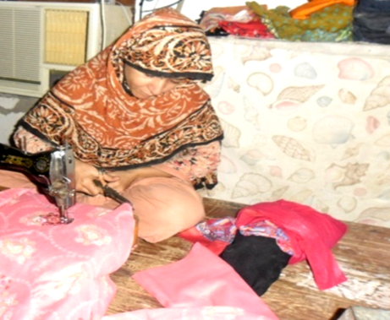
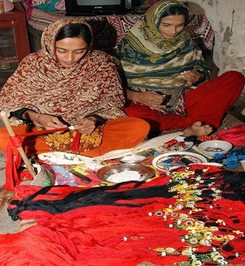
Pictorial View of Micro-Finance Initiatives in Sindh

Slide 21
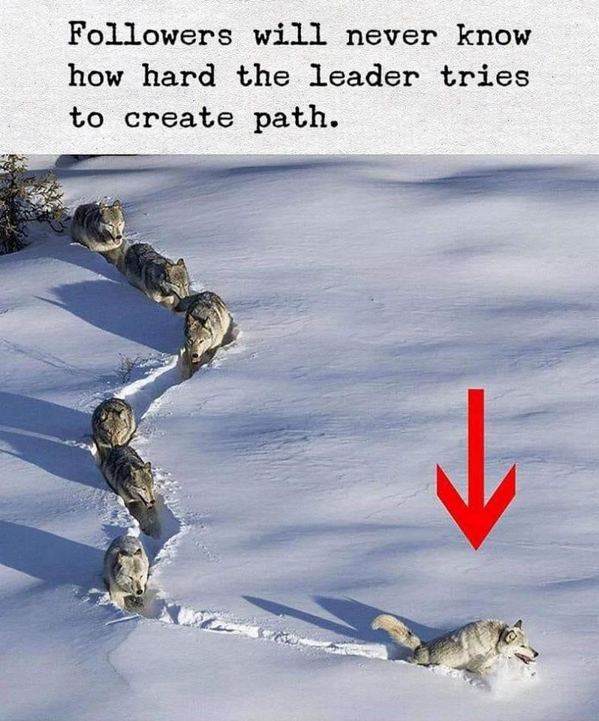
Thanks for patience

